Slide 1
Nuclear Fusion – Is it just a dream?
David Guszejnov

Slide 2
Why Fusion?

Slide 3
World Energy Roadmap
By 2050 current consumption will double
IPCC: Only way to avoid climate disaster is to massively invest in low carbon energy sources (renewables and nuclear)

Slide 4
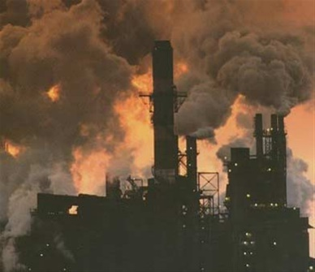

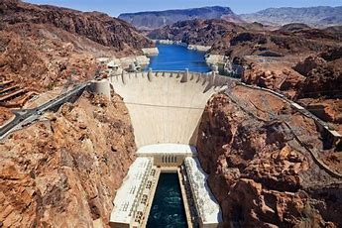
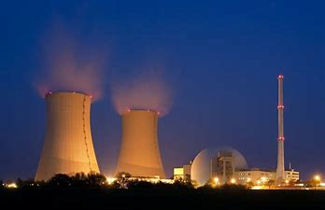
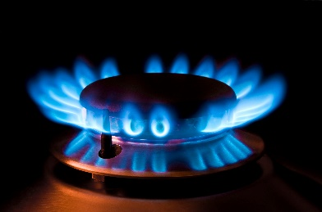
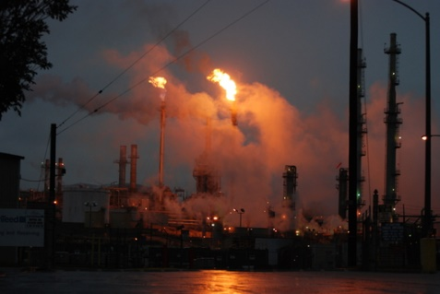
World Energy Roadmap
Low carbon sources

Slide 5
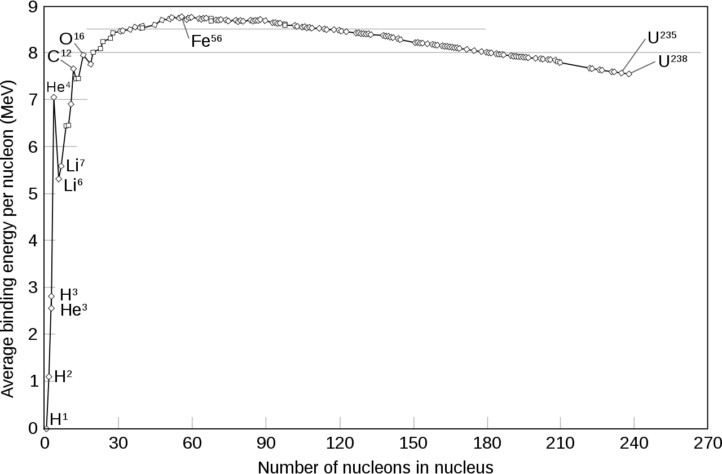
Basic Concept of Nuclear Energy
Fusion
Fission

Slide 6
The Promise of Nuclear Fusion
Advantages:
Abundant
D + T → ⁴He(3.52 MeV) + n(14.1 MeV)
From seawater
Unstable! Let’s make it ourselves!

Slide 7
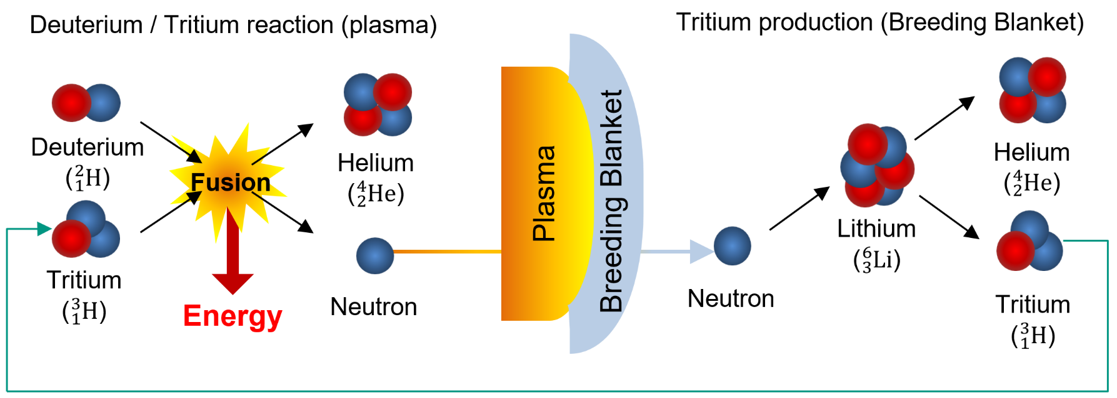
The Promise of Nuclear Fusion
Advantages:
Abundant
D + T → ⁴He(3.52 MeV) + n(14.1 MeV)

Slide 8
The Promise of Nuclear Fusion
Advantages:
Abundant Fuel from seawater and Li
Clean No CO₂ or no long-lived radioactive waste

Slide 9
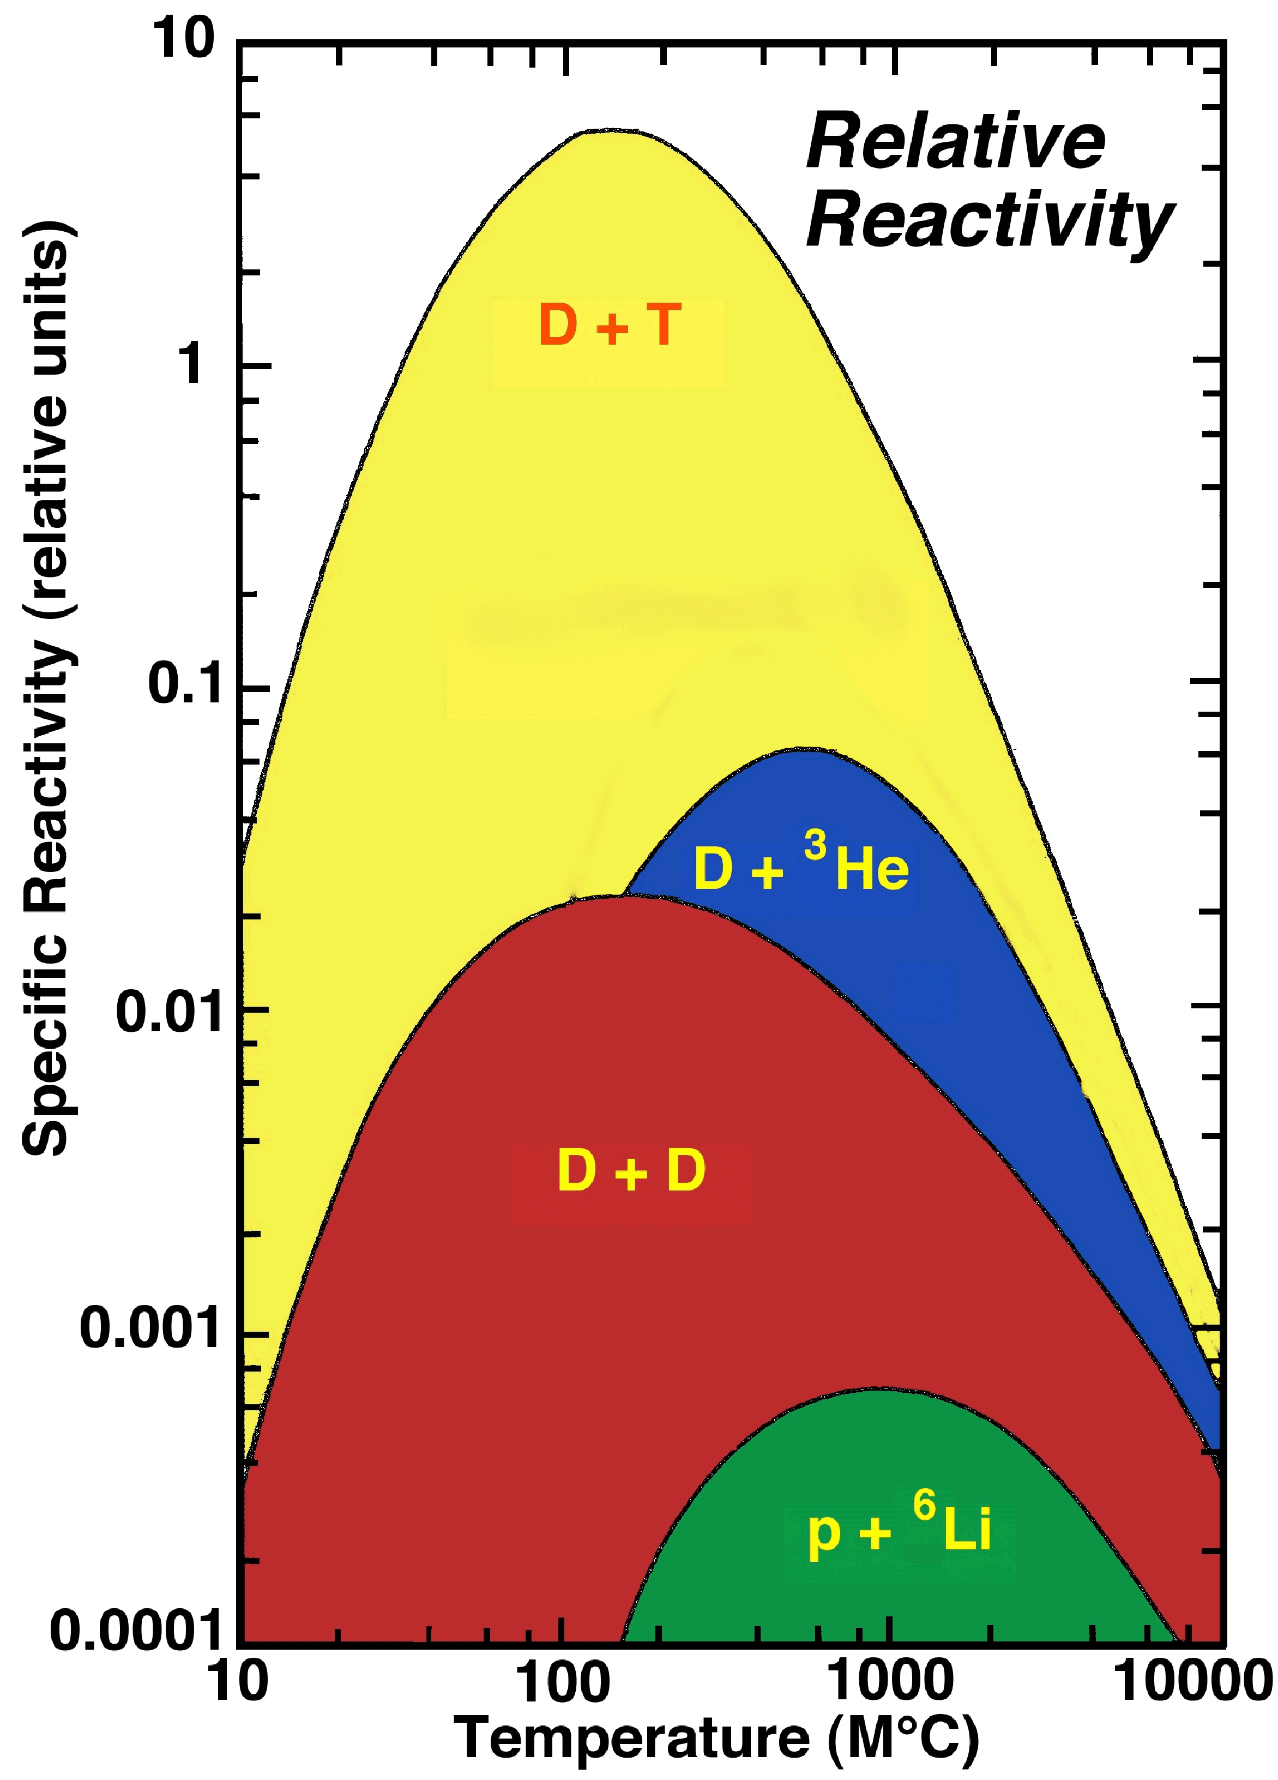
The Promise of Nuclear Fusion
Advantages:
Abundant
Clean
Safe

Slide 10
The Promise of Nuclear Fusion
Advantages:
Abundant Fuel from seawater and Li
Clean No CO₂ or no long-lived radioactive waste
Safe Negative feedback loop, not weaponizable
Disadvantages:
Does not work (yet!)

Slide 11
Realizing Fusion on Earth

Slide 12
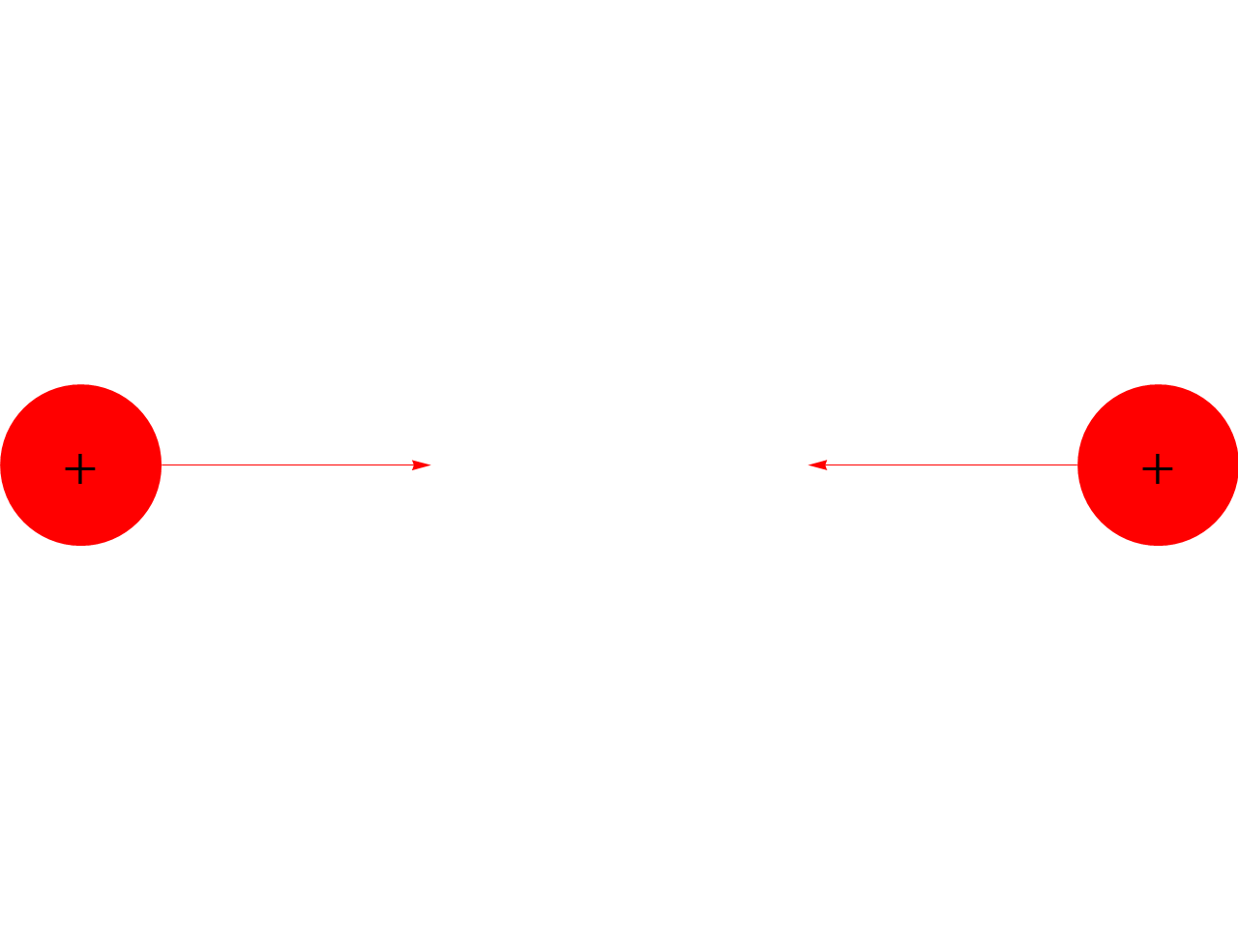
Temperatures
Problem:
Nuclei repel each other, high temperature needed to get them close enough to fuse
Strong interaction can only counter Coulomb on small scales
T ≈ 66 keV ≈ 100 MK
Fully ionized plasma
What are we going to out this in?
(All known solids melt above 5000 K)

Slide 13
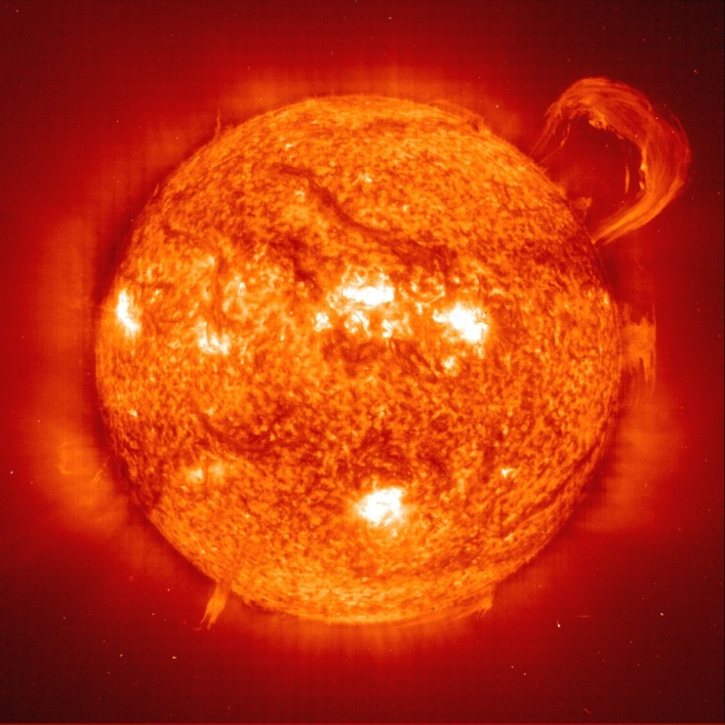
Question of Confinement
We need to hold the plasma together
Ideas:
Gravity

Slide 14
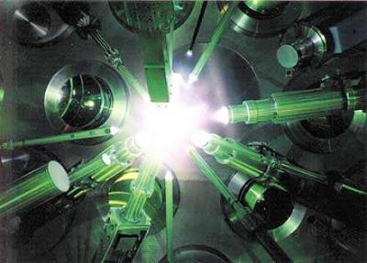
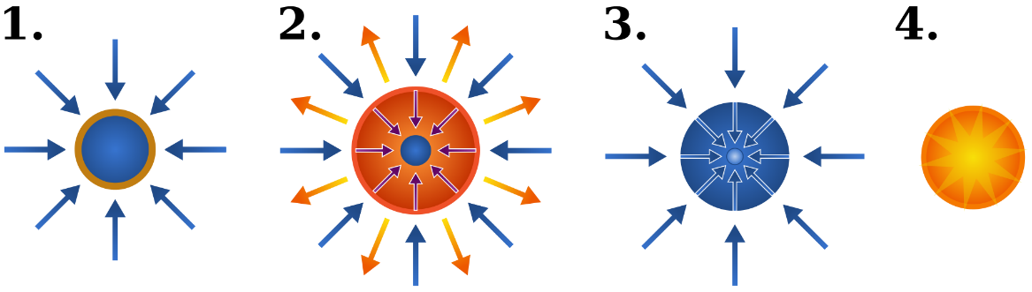
Question of Confinement
We need to hold the plasma together
Ideas:
Gravity
Inertia
Issue: needs high power, accurate, short burst lasers firing at high frequency
Lasers heat up a solid fuel pellet, the evaporating surface compresses the pellet until it the core ignites

Slide 15
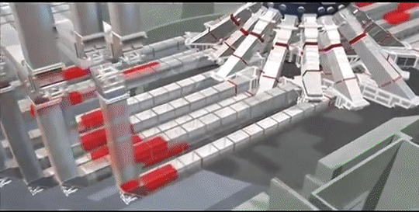
Inertial Confinement
Lasers heat up a solid fuel pellet, the evaporating surface compresses the pellet until it the core ignites
Issue: needs high power, accurate, short burst lasers firing at high frequency

Slide 16
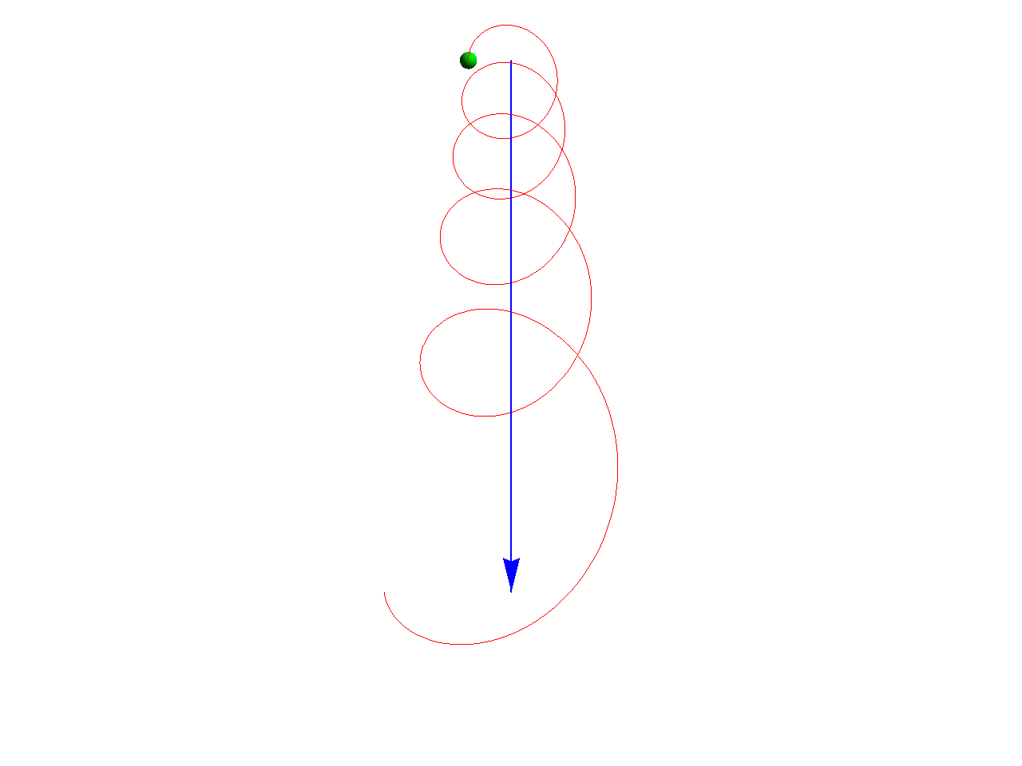
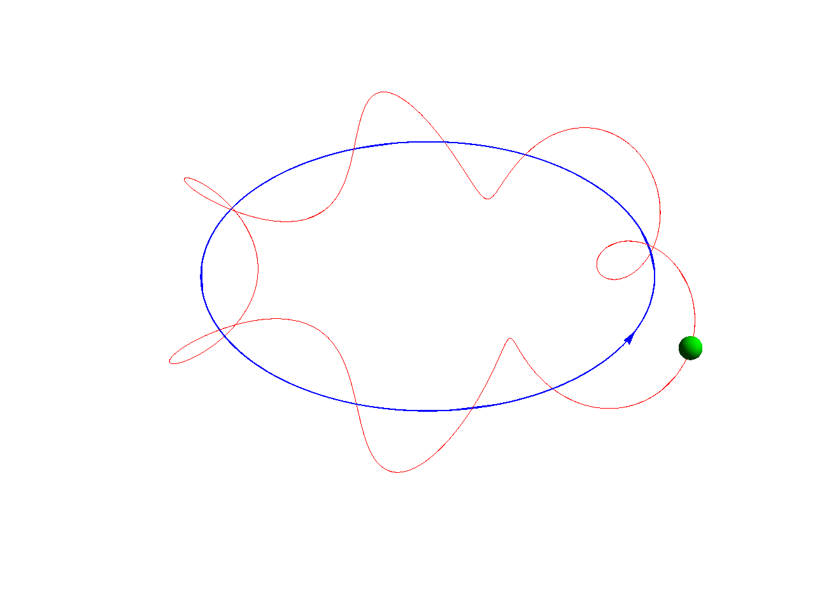
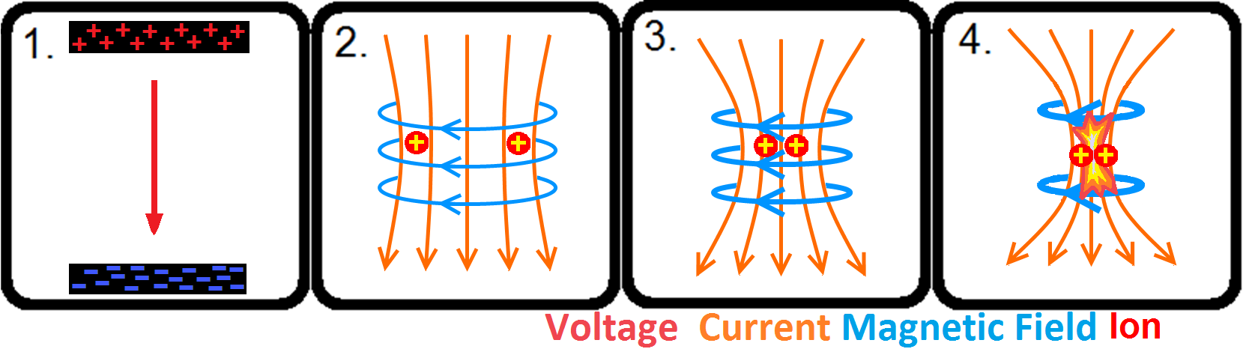
Question of Confinement
We need to hold the plasma together
Ideas:
Gravity
Inertia
Magnetic fields
Charged particles travel along magnetic fields
Escapes at the end? Not if there isn’t one.
Honorable mention: Pinch effect
So use a torus and everything is fine, right?

Slide 17
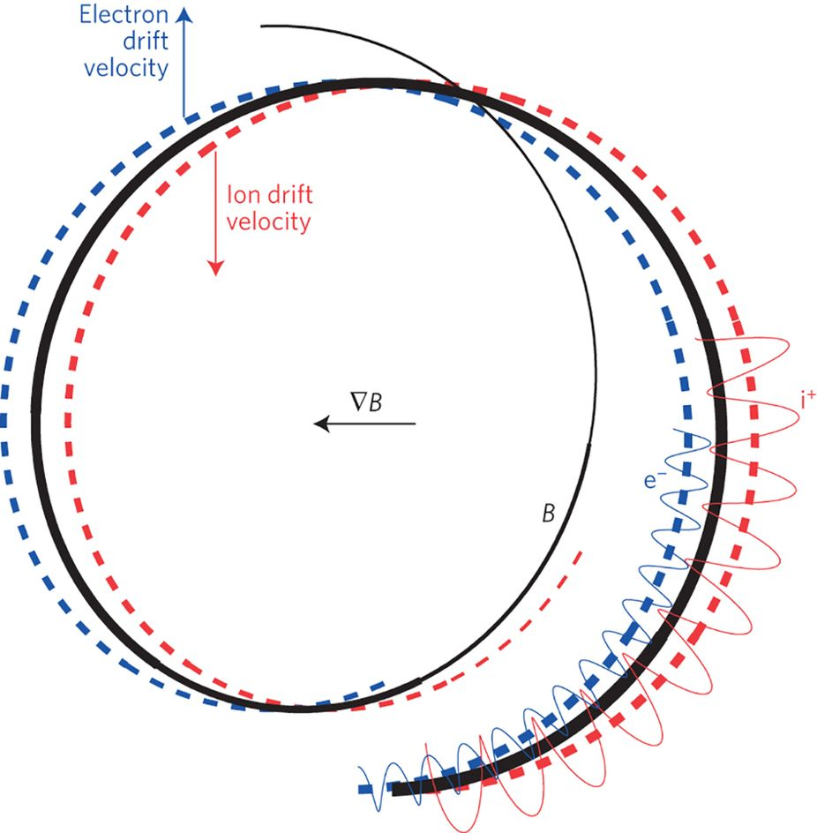
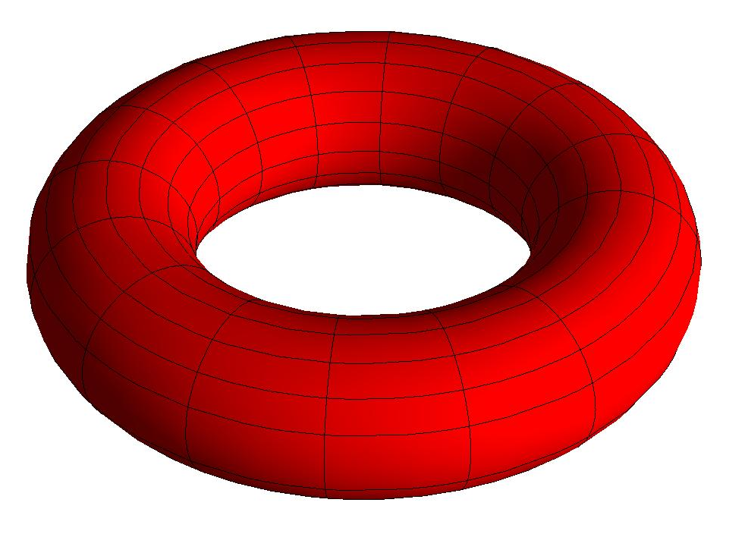
Magnetic Confinement in a Torus
Torus inner radius smaller inhomogenous B field
Idea:
Make particles spend equal amount of time at all radii
R_{inner}
Need to „twist” the magnetic field
R_{outer}

Slide 18
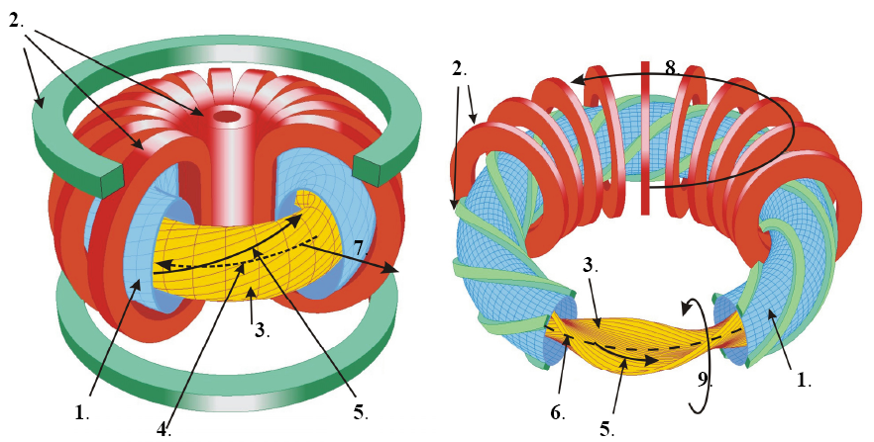
Magnetic Confinement in a Torus
Tokamak
Stellarator
(1) vacuum chamber, (2) magnetic coils, (3) plasma, (4) Plasma current, (5) magnetic field, (6) magnetic axis, (7) radial direction, (8) toroidal direction, (9) poloidal direction

Slide 19
Tokamak

Slide 20
Brief History
Tokamak (Toroidal Chamber with Magnetic Coils), the most popular fusion reactor design
Invented in 50’s by Tamm and Sakharov
Late 60’s, UK science cooperation, world learns that tokamaks have superior plasma properties compared to all other device types
„Tokamak stampede” in 70’s, oil crisis led to giant investments in fusion, largest device (JET - Joint European Torus) built.
80’s oil prices got low, funding dried up
From the 90’s almost all funding has been invested into ITER, the first experimental fusion reactor, opens in 2025 (actually starts science in 2035)

Slide 21
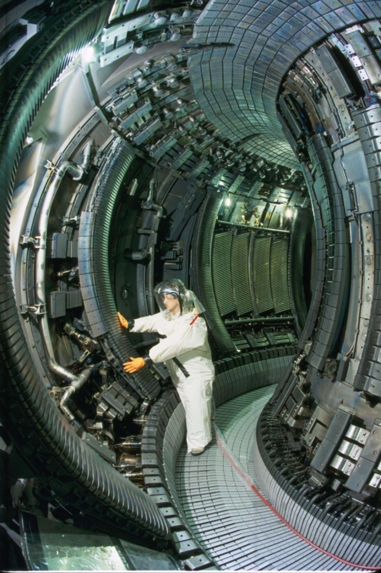

Inside a tokamak

Slide 22
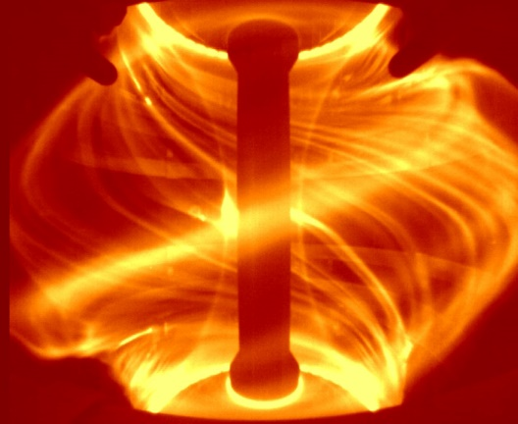
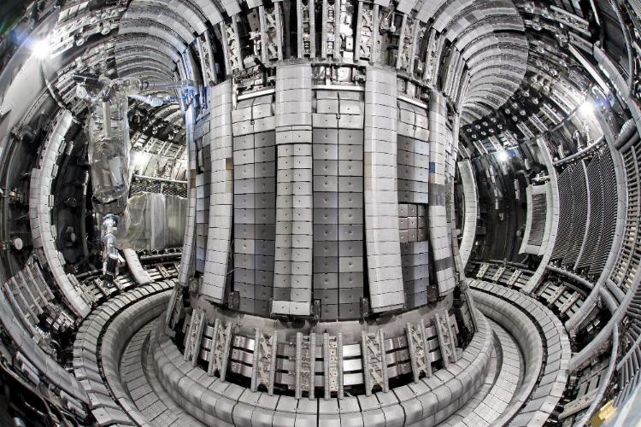

Challenges
Plasma Control
Materials
Politics & Economy

Slide 23
Plasma Control
Plasmas are extremely hard to control:
Very hot, must not touch anything
Evolves on ms timescale
Prone to dozens of exotic MHD instabilites
Added complications:
Internal energy generation (fusion), and external „hetaing”
Radioactive
Pellet injections to „feed” the plasma
Failure can destroy the device (but only that, it is not Chernobyl)

Slide 24
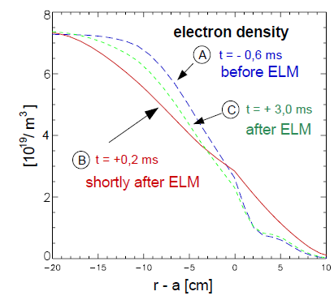
Plasma Instabilities
Many instabilities, here we focus on Edge Localized Modes (ELMs)
Transport barrier at plasma edge breaks down periodically
Large amount of heat and material deposited on walls
May cause plasma disruption

Slide 25
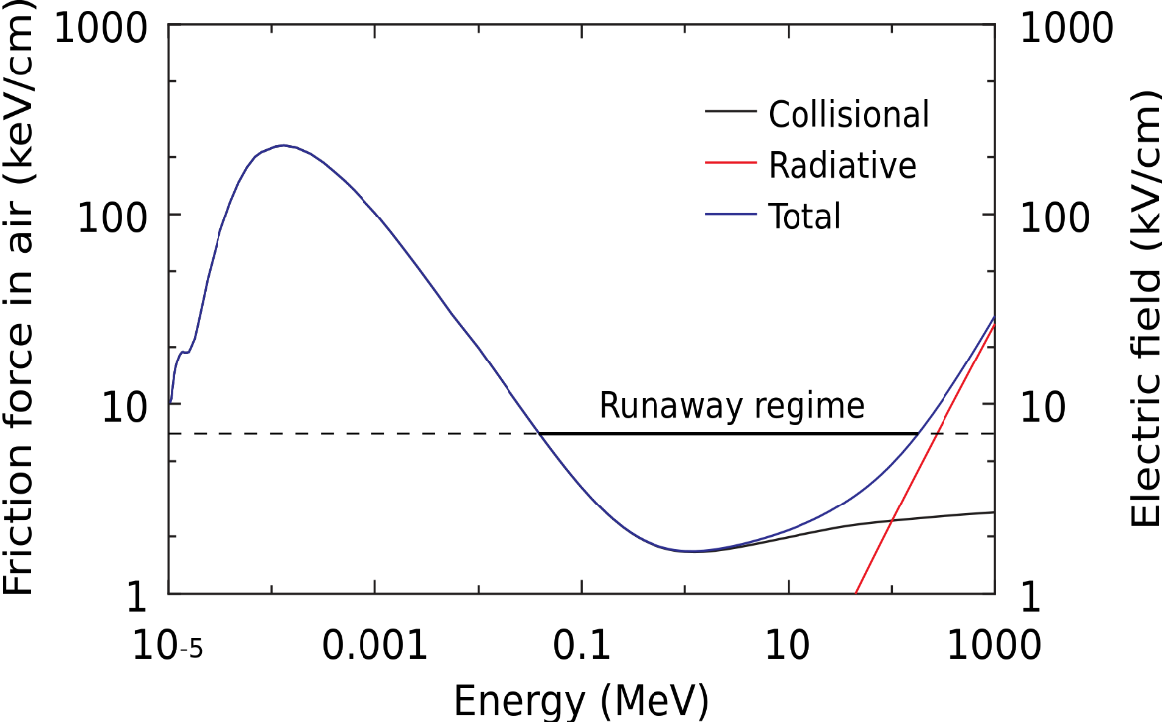
Runaway electrons
In plasmas dynamic friction may decrease with energy, leading to an avalanche of high energy (MeV) particles

Slide 26
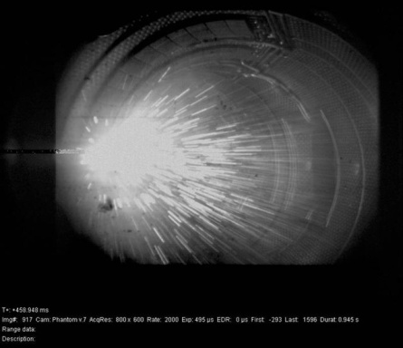
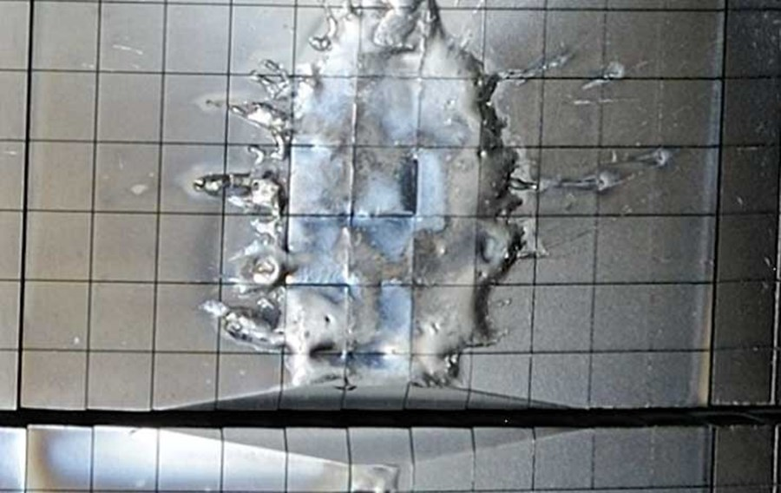
Runaway electrons
Can happen during plasma diruptions, the runaway electrons often create a self focusing beam that damages or even punctures the vacuum vessel

Slide 27
Material challenges
Fusion reactor environment
High magnetic fields (10 Tesla)
Average heat load of few MW/m² on walls
Wall periodicly hit by extreme heat load (few GW/m²)
Wall ablated by MeV particles
Extreme neutron flux
Extraction of radioactive Tritium from „breeder blanket”
„Affordable” ☺

Slide 28
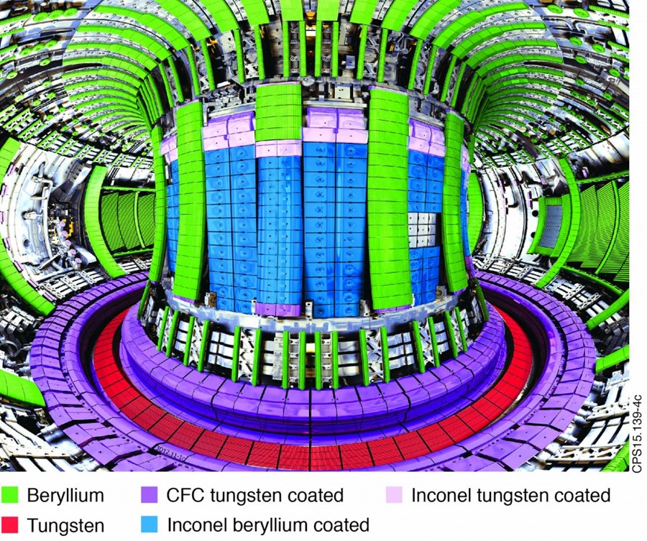
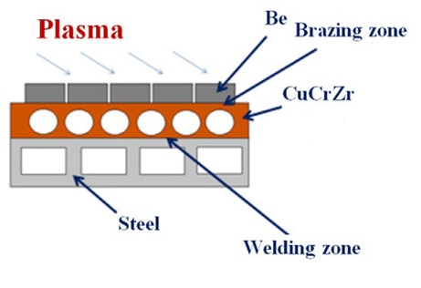
Material challenges

Slide 29
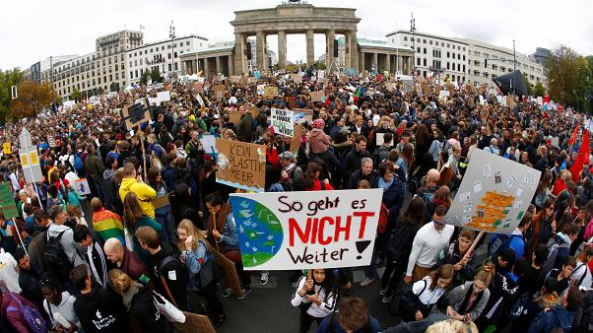
Politics and Economy
Nuclear fusion research has been chronically underfunded since the 80’s. But there are signs of renewed interest, both in public and private sector.

Slide 30
The ITER Project

Slide 31
ITER – The Way
Experimental fusion reactor in France
„iter” means „the way” in Latin (originaly Internation Thermonuclea Experimental Reactor)
International collaboration (EU, US, Russia, India, China, Japan S Korea)
Conceived in late 80’s, building started in 2009 to be finished in 2025
Cost (est.): 20 – 30 billion USD (about NASA’s budget or one new US aircraft carrier)
Aims (after 2025, after 2035):
Maintain and control >8 min plasma pulses
Peak Q>10 efficiency, steady state Q>5 (Q>3 needed to break even in power generation)
Develop Tritium breeding
Test neutron shield/heat energy conversion

Slide 32
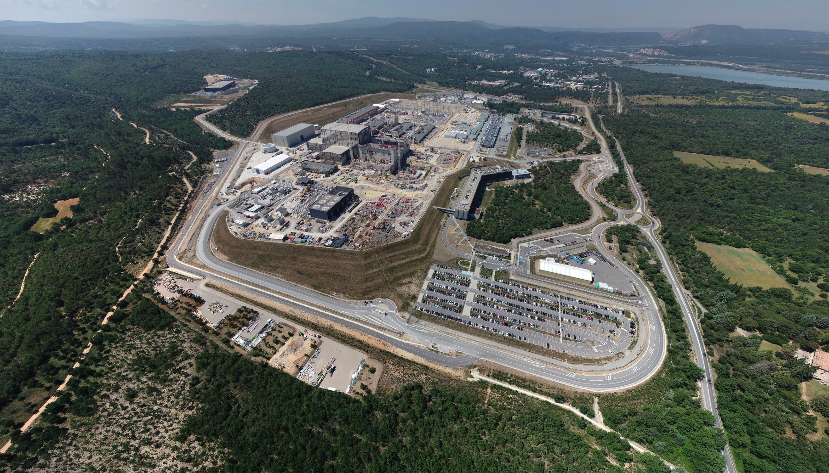
ITER – Current state

Slide 33
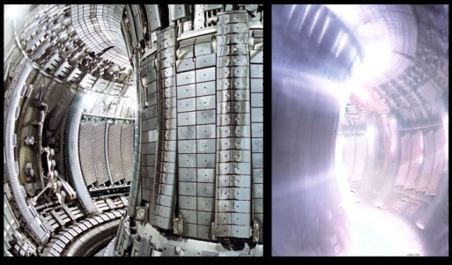
Summary
Nuclear fusion is promises to transform our lives, but we don’t know yet if it is feasible. If it is (will know by 2035), commercial operations will likely start in the 2050’s (i.e., too late for climate action).

